Slide 1

Introduction to Modern NLP
with Hugging Face and CORD-19
Nick Acosta

Slide 2
Before we start…
IBM Data & AI / April 16, 2020 / © 2020 IBM Corporation
2

Slide 3
Google Colab
ibm.biz/LearnAInb

Slide 4
Agenda
Part One – Introduction 01
Setup 02
Agenda 04
Part Two - CORD-19 05
Producers and Kaggle competition 06
Example 07
Part Three - Hugging Face 08
NLP 09
Transformers the library 10
Transformers the models 11
Part Four – Lab 17
Part Five – Conclusion 20
Resources
Q&A
4

Slide 5
CORD-19

Slide 6
CORD-19

Slide 7
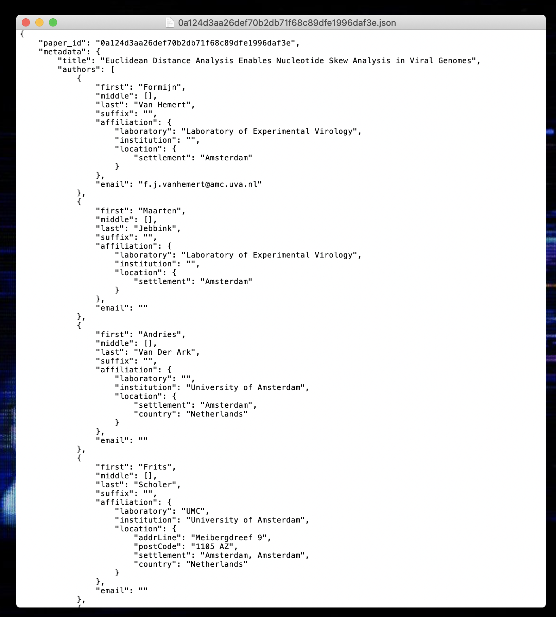
CORD-19

Slide 8
Hugging Face

Slide 9

NLP
Multiple Choice
Next Sentence Prediction
Sequence Classification
Token Classification
Question Answering
Text Generation
NLP
IBM Data & AI / April 16, 2020 / © 2020 IBM Corporation
9
Notes:
Natural Language Processing (NLP) is a branch of artificial intelligence concerned with understanding natural language
Technology can do this in a number of ways, just some on which are listed on the slide
Multiple Choice - The model correct selects an answer given multiple options. Guessing the next caption in a video.
Next Sentence Prediction - Given two sentences, a mode predicts whether the second came after the first “But the film is a saddening bore. Because I wrote it ten times or more” -> yes
Sequence Classification - The model assigns a sequence of text to a particular category. Sentiment analysis
Token Classification - Each word (token) is a sequence is classified against a list of options. Part-of-speech tagger
Question Answering - Given a paragraph of text, provide an answer to a question illustrating reading comprehension of the paragraph.
Text Generation - Given a sequence of text, a model prediction the next sequence(s) Google Search

Slide 10
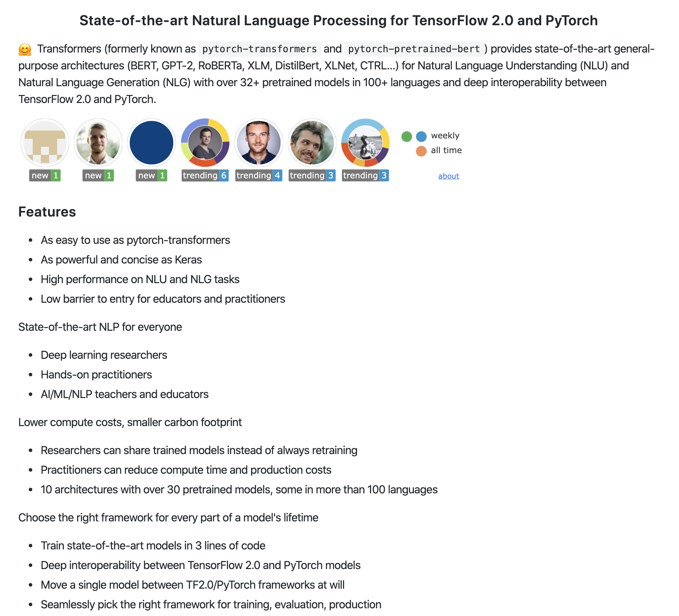
Transformers the library

Slide 11
Transformers the models
State of the art in multiple NLP tasks
Focus on self-attention and multi-headed attention
mixed frontend
M
11
Notes:
Transformers are gaining a lot of popularity recently for their state-of-the-art performance in a number of nlp tasks. More information on these breakthroughs are in coming slides

Slide 12
Transformers Resources
BERT Introduction
The Illustrated Transformer
The Illustrated GPT-2
12

Slide 13
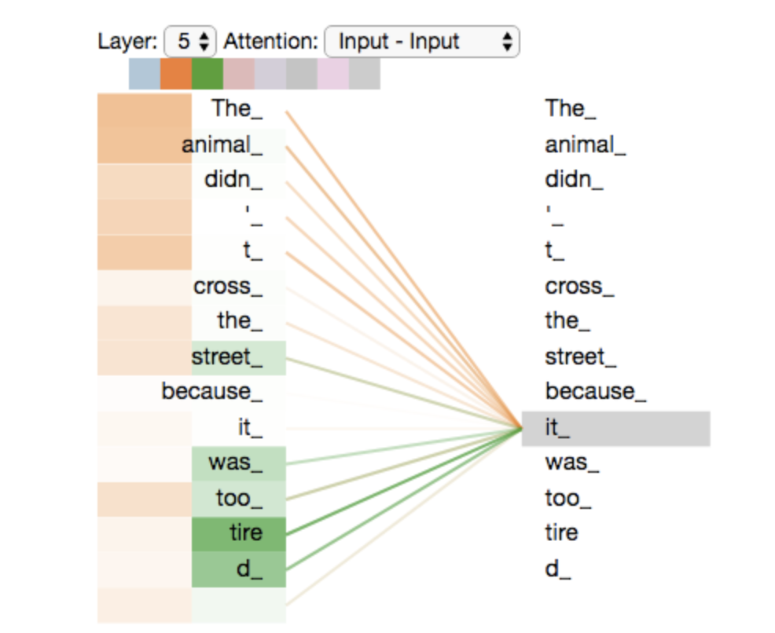
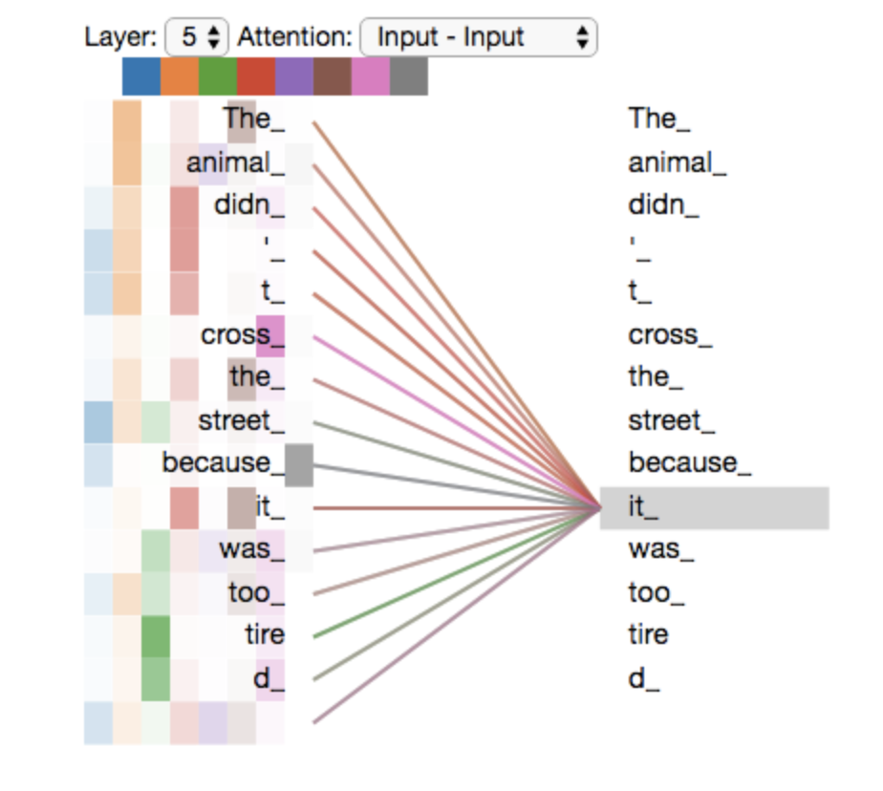
Self attention and multiheaded attention
13
Notes:
A key component of transformer models is attention. Transformers implement attention in a way that is parallelizable to speed training. Attention layers encode each input token by also examining all words surrounding the token in a sentence, and work particularly well on large sequences. These attention layers are also present in the decoding layers of a transformer model

Slide 14
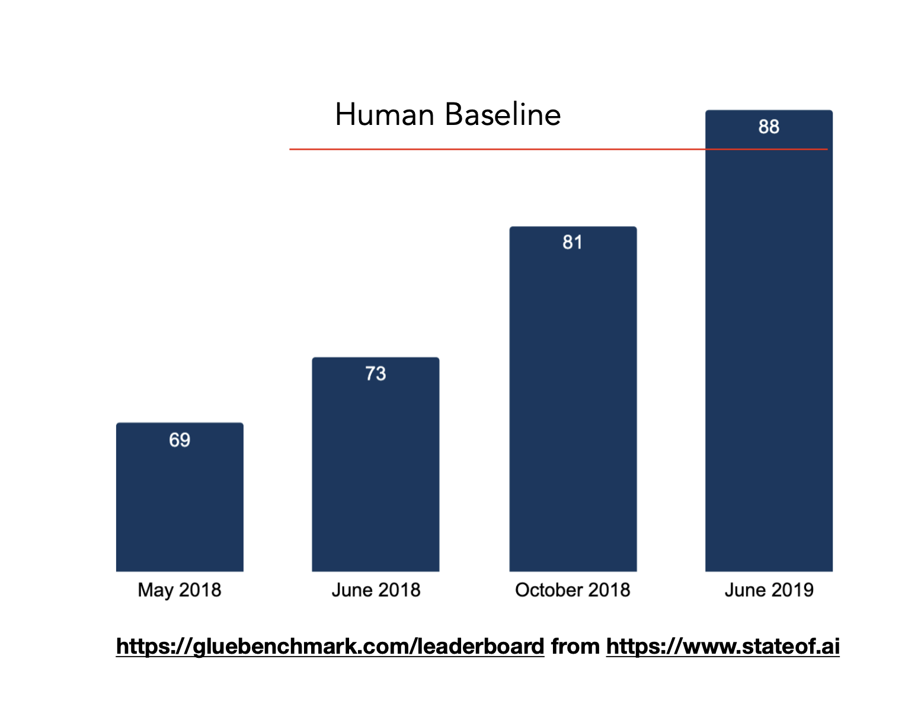
Transformers Results
14
Notes:
Transformers have led to a number of significant advancement in NLP.
Here you can see the accuracy for state-of-the-art models in performing text classification on the GLUE benchmark dataset, which passed even human performance just last summer.

Slide 15
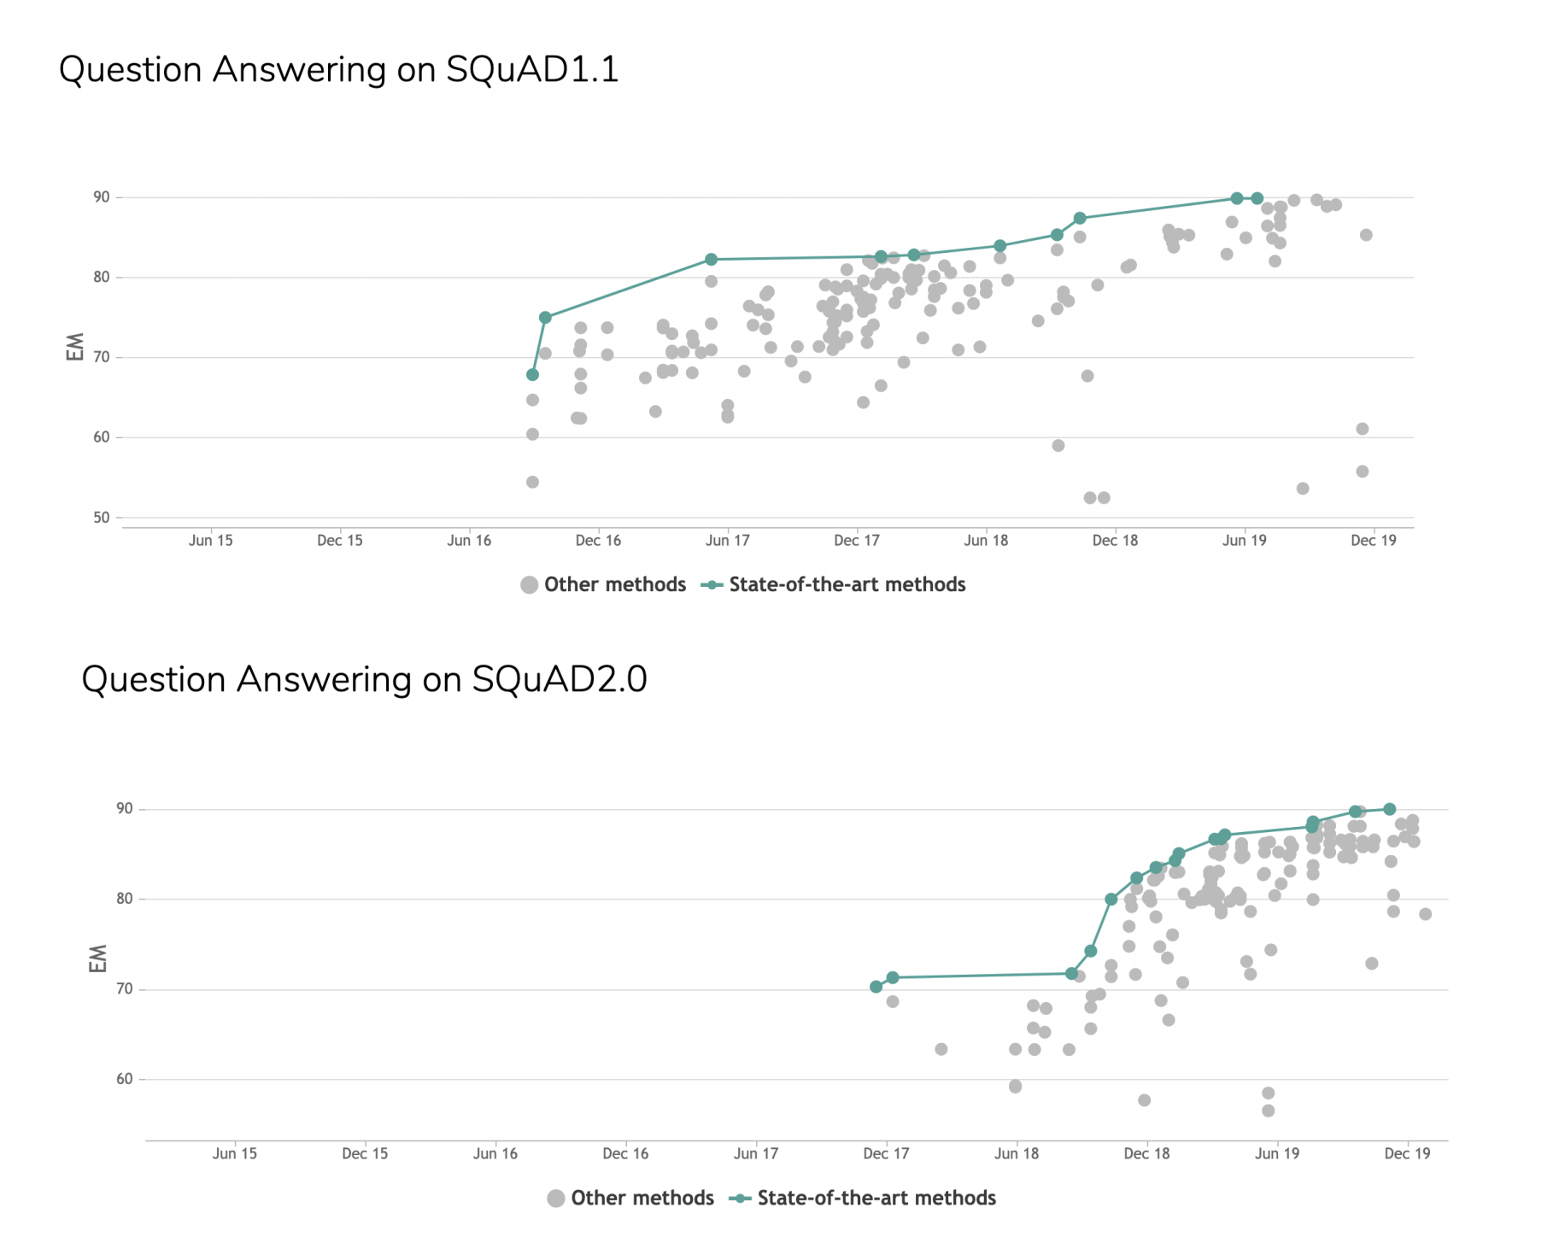
Transformers Results
15
Notes:
Every area of NLP is being affected. Here you can see how the state-of-the-art has rapidly progressed in the Question Answering domain on some SQuAD benchmarking datasets

Slide 16
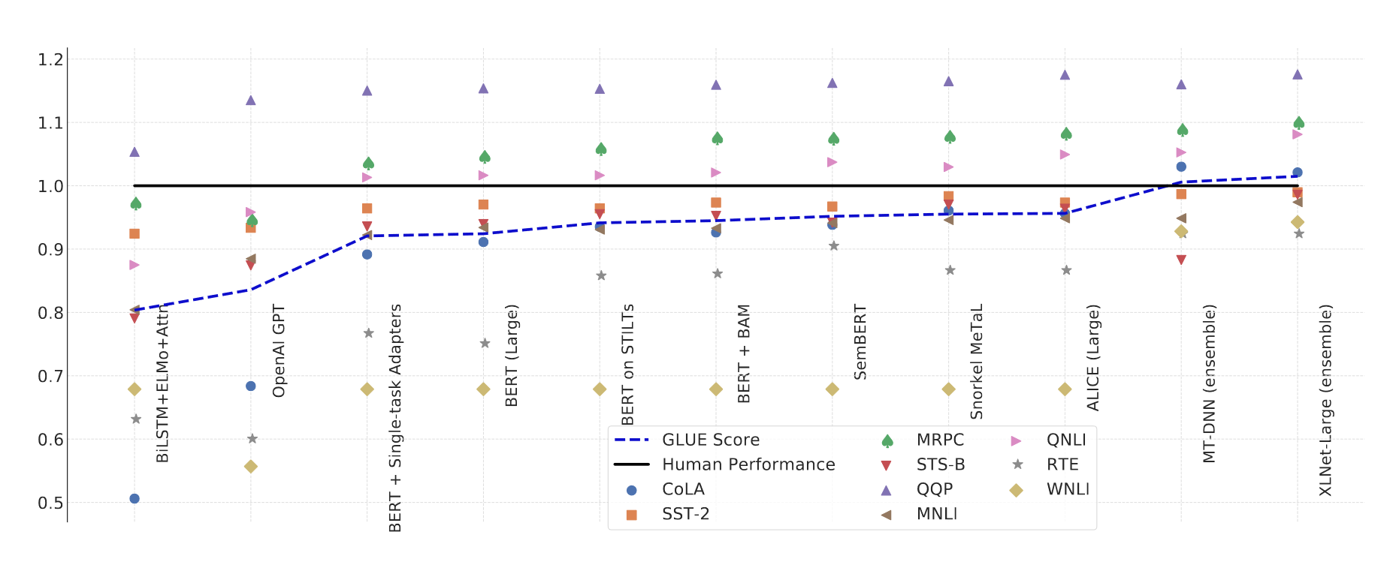
Transformers Results
16
Notes:
Further evidence that every area of NLP is being affected by transformers. Each dot on this graph represents a different NLP benchmarking task and dataset. The x-axis show various transformer model, and the y-axis show how many of the are outperforming, and sometimes significantly outperforming, humans in NLP tasks.

Slide 17
Lab
17
Notes:
This section will walk through examples of how the models on the previous slide can be used in a novel way, to classify and generate code of the deep learning frameworks mentioned earlier, TensorFlow and PyTorch

Slide 18
Acknowledgements
Daphne Ippolito
Denny Lee
Patrick von Platen
IBM Data & AI / April 16, 2020 / © 2020 IBM Corporation
18

Slide 19
Disclaimer
IBM Data & AI / April 16, 2020 / © 2020 IBM Corporation
19

Slide 20
Introduction to Modern NLP
with Hugging Face and CORD-19
Nick Acosta
nacosta@us.ibm.com

Slide 21
Explainable Data Science
with Lale and AIX360
Austin Eovito

